Slide 1

Debugging under Unified Extensible
Firmware Interface (UEFI):
Addressing DXE Driver Challenges
Joe Chen
Sr. Manager, Insyde Software

Slide 2
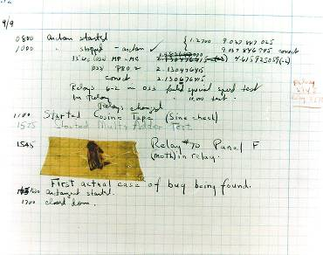

Debugging Then…
The first computer bug, a moth removed from the Mark II in 1947, is now at the Smithsonian museum
Grace Hopper, whose many
accomplishments included
writing the first compiler,
popularized the term “Computer Bug”

Slide 3
Agenda
…Debugging Now
Benefits of the UEFI Architecture
Tips for Project Planning
Debugging Tools

Slide 4
UEFI is Architected for Modularity
Benefits of the UEFI Architecture
UEFI-
enabled
OS
Pre-boot
Tools
Option
ROMs
Today’s
OS
UEFI is an interface specification
Allows Driver Encapsulation
As supported devices migrate to new market segments, the driver can easily follow
  Same driver for Mobile
  For Desktop/Server
  For Embedded Too!
UEFI
Framework
Drivers
IBV z
Drivers
Compatibility Support Module A
OEM /ODM
Drivers
IBV
Drivers
Compatibility Support Module
MRC - CPU
Architectural Protocols
Foundations
Hardware

Slide 5
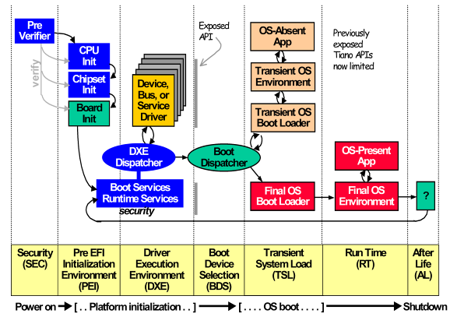
UEFI Has a Defined Control Flow
Benefits of the UEFI Architecture
UEFI/Framework boot process goes through defined stages with clear rules for each stage
DXE Debug

Slide 6
UEFI is Architected for Debugging
Benefits of the UEFI Architecture
Uses clear inter-module interfaces called protocols
Drivers often both consume and produce protocols
Driver writer should treat platform service protocols as a ‘black-box’
Calling Module
References
Protocol
Agreed
Protocol
Definition
Provider Module
Publishes
Protocol

Slide 7
Agenda
Benefits of the UEFI Architecture
Tips for Project Planning
Debugging Tools

Slide 8
Plan Early for Debug
Project Planning Tips
When designing your board consider:
  Firmware Storage, initial load
  Debugger tool Connections
  Serial Debug Output
When starting driver or application project consider:
  Utilize UEFI Modular Architecture
  Possible to test in the Shell?
  CPU modes – IA32, x64, EBC

Slide 9
Agenda
Benefits of the UEFI Architecture
Tips for Project Planning
Debugging Tools
  Hardware (Jtag) Debuggers
  Software Debugger Tools
  Macros from Tianocore.org

Slide 10
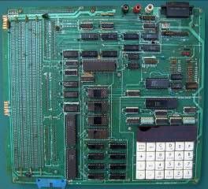
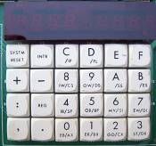
Debugging Then…
Debugging Tools
Released in 1979, the SDK-86 was Intel’s first Reference Board. It offered a full-featured debugger in ROM with keypad and serial interface. All of its debugger commands are still used in debuggers today.

Slide 11
Standard Today -Source-level Debugging
Debugging Tools
Source Level View of Target on developer desktop
Set Breakpoints in target–
  Execution - software and hardware
  Hardware breakpoints for memory or I/O access
Go/step control -> step into, step over, etc.
Dump registers and memory, dump indexed registers, dump PCI registers, etc.
Dump UEFI tables

Slide 12


American Arium
JTAG Source-level Debugger
ECM-XDP3
Debugging Tools
Hardware Debugger

Slide 13
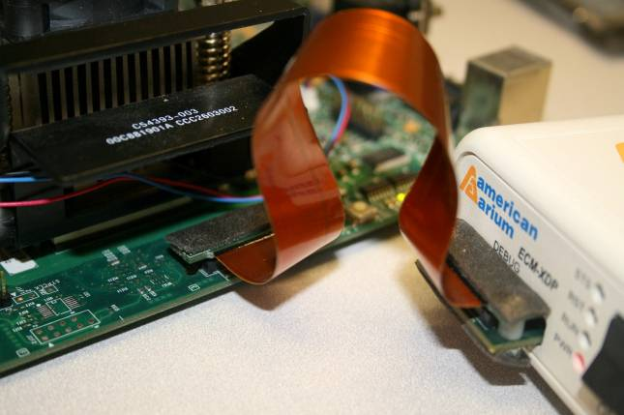
American Arium- ITP Jtag Connection

Slide 14
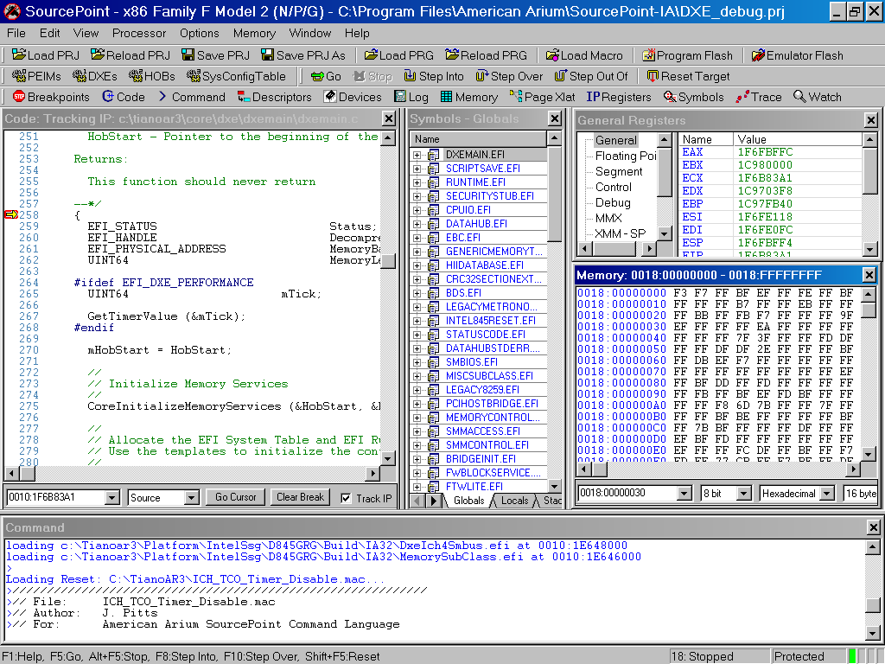
American Arium H/W Debugger Application Interface
Debugging Tools

Slide 15

Hardware Debugger Useful in All Stages
Debugging Tools

Slide 16
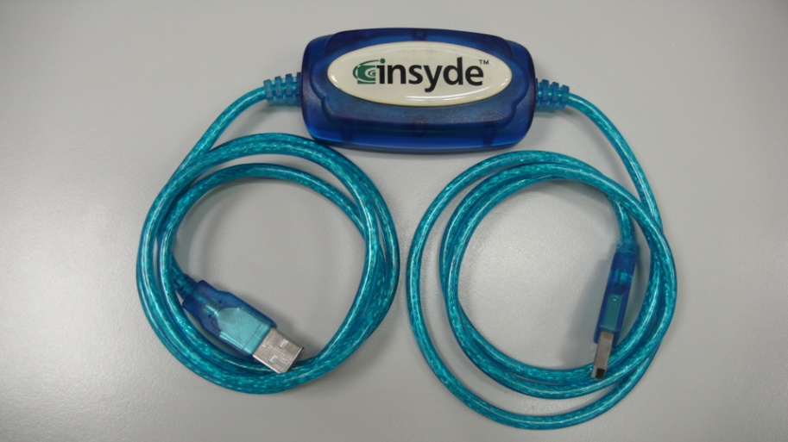

Platform Software Debugger
Debugging Tools
H2ODDT™ from Insyde Software
Operating System
UEFI
Firmware
Hardware

Slide 17

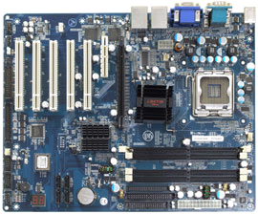
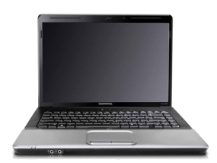

H2ODDT from Insyde Software
Debugging Tools
Connects to Target USB Port 0
USB0
Developer
System
Firmware w/ H2ODDT
Included
Target Board

Slide 18
H2ODDT Features and Requirements
DDT drivers are built into the firmware image which is then flashed to the platform
Versions for IA32 and x64
Must use target USB Port 0 (which has special debug mode)
Debugging capability from PEI init through DXE into boot phase
Includes debug of SMM drivers and legacy option ROMs

Slide 19
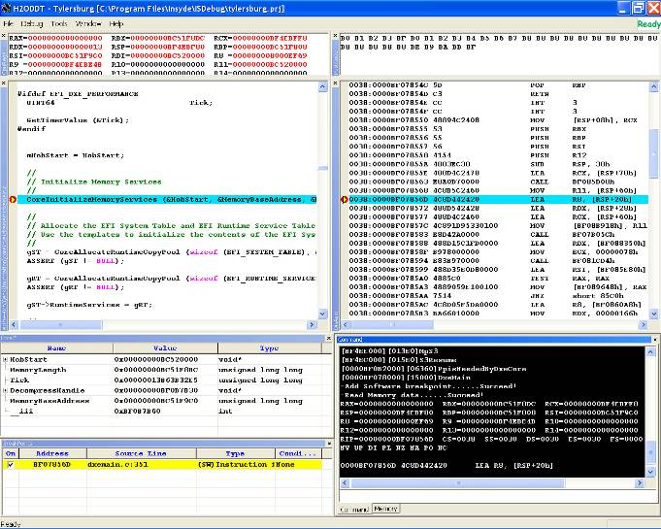
H2ODDT Gives Full Source View
Debugging Tools

Slide 20
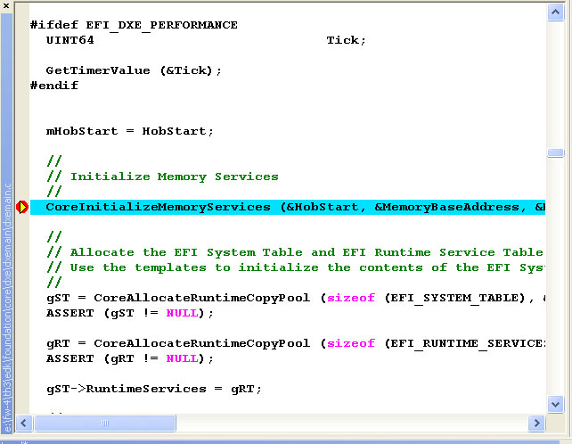
See Your Code In Action!

Slide 21
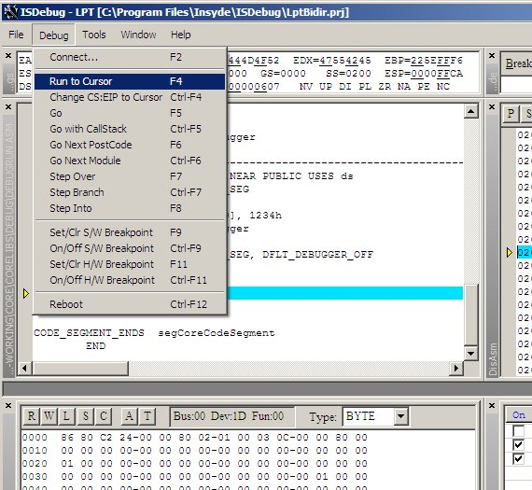
Complete Step Control Over Target
Debugging Tools

Slide 22

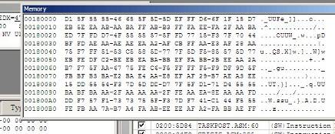
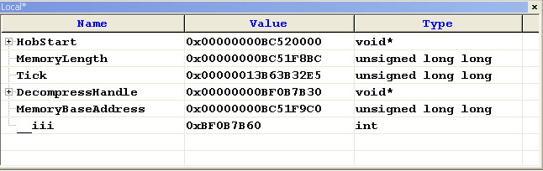
More H2ODDT Features
Debugging Tools
Register viewer
Memory dump viewer
Local and Global Variables

Slide 23
H2ODDT Platform Software
Debugger Useful Throughout the Boot
Debugging Tools

Slide 24
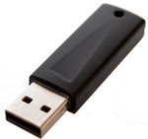
New From Insyde: Shell-level Debugger
Debugging Tools
“DDT-AD” = Debugger for Applications and Drivers
Operating System
UEFI Applications
UEFI Driver
+
UEFI
Firmware
Hardware

Slide 25
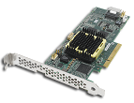


“DDT-AD” Software Debugger for Shell-Level Debug
Debugging Tools
Board needing driver
USB0
Developer
System
Thumb Drive
w/ DDT-AD Driver
Host Board

Slide 26
“DDT-AD” Features and Requirements
Debugging Tools
Debug your drivers using any UEFI-compatible platform
DDT-AD is loaded from UEFI Shell Prompt using Flash drive or other media
Capability to debug anything that can be loaded from the Shell
Same cable and source-level debug features as standard Insyde H2ODDT

Slide 27

DDT-AT Lets You See Inside Your Driver
IHV APP
TEST APP
DDT-AD
UEFI SHELL
IHV DRIVER
UEFI API INTERFACE
UEFI-COMPATIBLE
PLATFORM
IHV HARDWARE

Slide 28
Strengths of “DDT-AD”
Easy setup – no need to build debug firmware image
Simple connection using USB cable
Look inside the source of the driver or application under test
Debug problems on any UEFI board
Useful for many segments – OEM/ODM and IHV, driver and application

Slide 29
“DDT-AD” Status
Insyde is beginning Beta-test
Is this tool interesting to your company?
Send email to debug@insydesw.com

Slide 30
DDT-AD Used in Shell Environment
Debugging Tools

Slide 31
DEMO: DDT-AD Debugger

Slide 32
Source Debuggers - Tips and Tricks
Debugging Tools
Compiler optimization can make source display hard to follow
  Local variables often held in registers, code order may be rearranged…
  Include this statement in your source to disable optimizer:
  #pragma optimize ( “” , off )
Include this statement in your source to hard-code a breakpoint at any point
  __debugbreak() compiler intrinsic

Slide 33
More Source Debugger Tips…
Same source can be built for native CPU or EBC binary so usually recommended to debug drivers in native first and then retest in EBC before release
Problems in EBC drivers can be checked with EBC Debugger
  http://www.uefi.org/events/EBC_debugger.zip

Slide 34
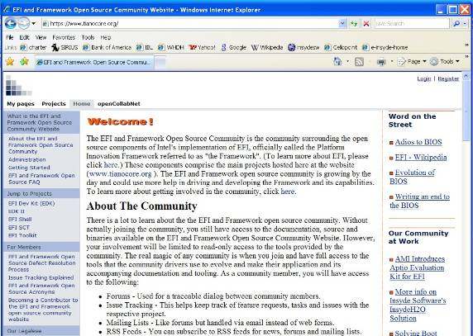
Software Debug Macros
Debugging Tools
From www.tianocore.org

Slide 35
EDK Debug Macros from tianocore.org
Debugging Tools
These Macros Output to serial port
DEBUG (ErrorLevel, String, …)
  printf-like formatted print string if ErrorLevel is active
ASSERT (Expression)
  If Expression is FALSE, then print file name and line number and halt.
ASSERT_EFI_ERROR (Status)
  If Status is not EFI_SUCCESS, then print file name and line number and halt.
CR (Record, Type, Field, Signature)
  ASSERT()s if Data Structure Signature does not match
EFI_BREAKPOINT ()
  Generate a CPU break point instruction

Slide 36
Review: Debugging Tools
Debugging Tools
 | Board Connection | Strengths
Hardware Debugger | ITP Jtag | Full Source view, break if hung
H2ODDT Platform Software Debugger | USB Port 0 | Full Source view and breakpoints with no special connector
DDT-AD Shell-level Debugger | USB Port 0 | Easy to use tool for UEFI driver and application development
In-source Macros | Serial | Free but still useful in project

Slide 37
Summary
Conclusions
UEFI architecture is modular and designed for debugging
Plan early so board design includes required debugger-support features
Several debugger tools available: choose the best tool for your project

Slide 38
Call To Action
The industry is moving to UEFI and conversion has many benefits.
Plan early to include debugging and make your UEFI project a success.
Select one of these easy to use tools to increase productivity!

Slide 39
Resources
Web based information:
  www.uefi.org
  www.tianocore.org
  www.intel.com/technology/efi/
  www.arium.com
  www.insydesw.com

Slide 41

Questions?

